Slide 1
Real time vehicle trajectory estimation on multiple lanes
Kristian Kovačić, Edouard Ivanjko, Hrvoje Gold
kristian.kovacic@fpz.hr

Slide 2
University of Zagreb
Faculty of Transport and Traffic Sciences
Outline
Introduction
Vehicle detection
Vehicle trajectory estimation
Vehicle detection speed up
Experimental results
Conclusion and future work

Slide 3
Introduction
New ITS based traffic control approaches need real time data
Video camera is more and more used for traffic parameters measurement
Vehicle detection for flow and velocity measurement
Origin-Destination (OD) matrices
License plate recognition, etc.
Problem
Tracking vehicles on multiple lanes simultaneously with only one camera
Commercial versions need one camera per lane

Slide 4
Vehicle detection
Image import
IP camera, video file
Preprocessing algorithm
Noise reduction
Gaussian filter with 5x5 matrix

Slide 5
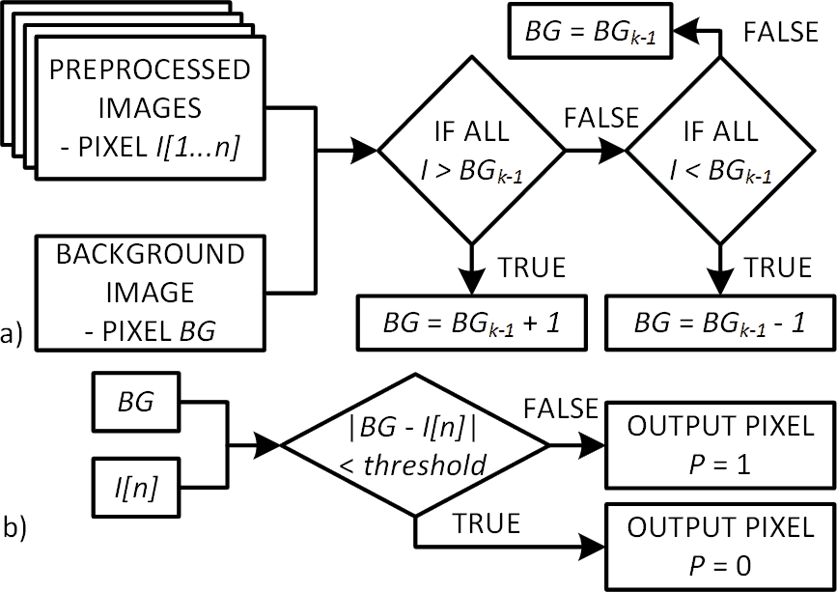
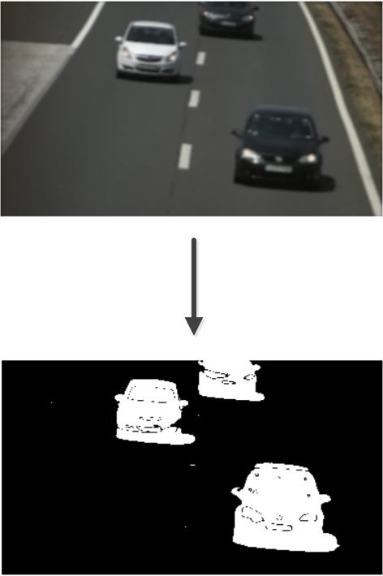
Vehicle detection
Background substraction method
(a) Creation of background image model
(b) Detection of foreground objects

Slide 6
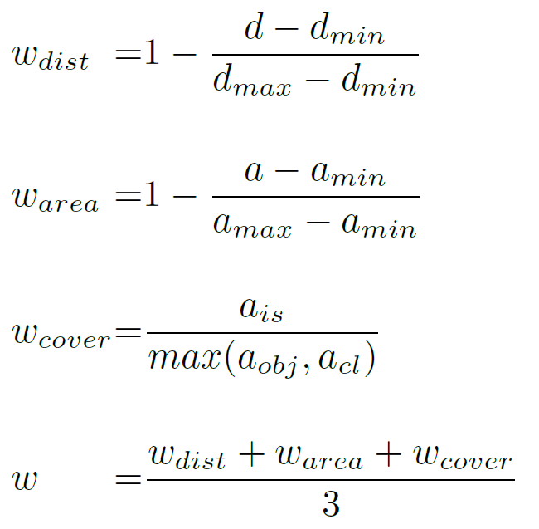
Vehicle detection
Vehicle trajectory estimation
Object clustering method
Check if adjacent pixels exist and combine them into cluster
If cluster area A ≤ threshold, remove cluster
Object tracking method
Compare all objects in the new frame with objects in the previous frame and combine only those with max w
3
2
1

Slide 7
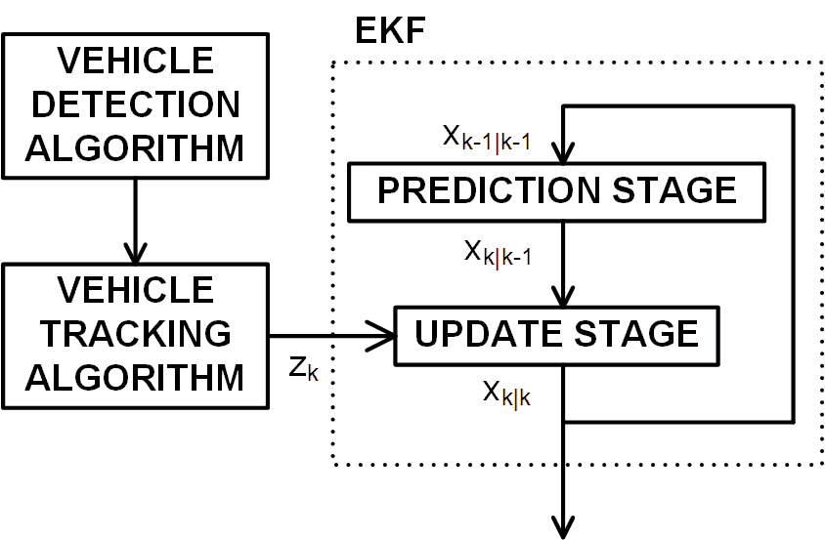
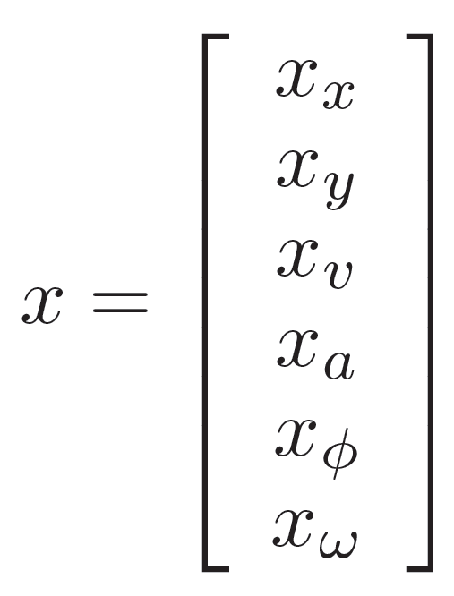
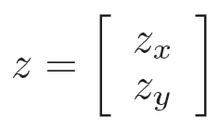
Vehicle trajectory estimation
Postprocessing object location
Extended Kalman Filter
Histogram for computing average values of position (x, y), velocity (v), acceleration (a), direction (ϕ), angular velocity (ω) based on EKF output
Setting initial values of state vector x by histogram
State vector
Measurement vector

Slide 8
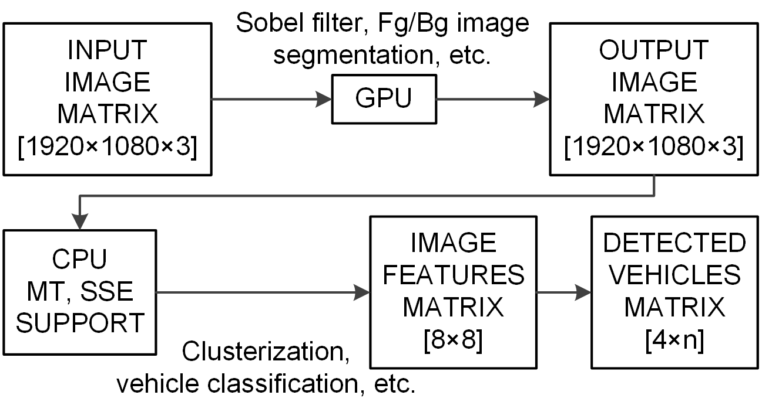
Vehicle detection
Speed up
Optimization approach
Executing algorithms on GPU as much as possible
Adding support for CPU SIMD instructions to algorithms which are incapable to run on GPU
Performing computations using multiple threads
Parallelization of image processing algorithms

Slide 9
Experimental results
Vehicle detection accuracy
Vehicle counting approaches
Check if vehicle bounding box / trajectory is overlapping with one of virtual markers
Approach |  | Vehicle count per lane
 |  | Total | Left | Right
Overlap check | Hits | 126 | 65 | 61
 | FP / FN | 0 / 6 | 0 / 5 | 0 / 1
 | Accuracy | 95,6% | 92,9% | 98,4%
Trajectory check | Hits | 129 | 68 | 61
 | FP / FN | 1 / 4 | 0 / 3 | 1 / 1
 | Accuracy | 96,2% | 95,8% | 96,8%
True vehicle count |  | 132 | 70 | 62

Slide 10
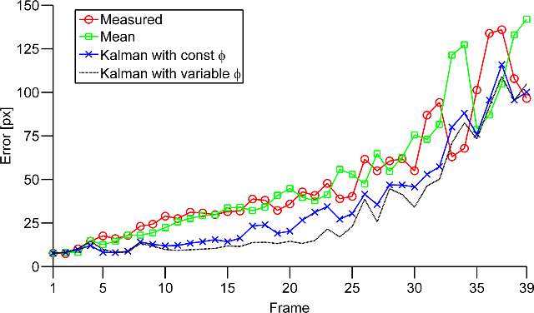
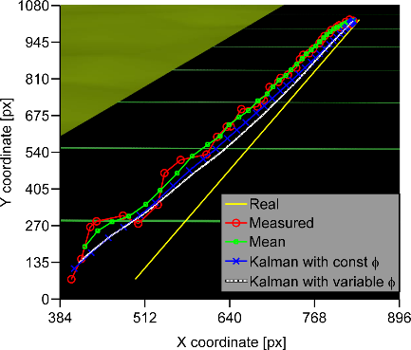
Experimental results
Vehicle trajectory estimation accuracy
Simulation of 3D road traffic scene with known parameters
Synthetic environment designed in Autodesk 3ds Max
Noise added to measured trajectory

Slide 11
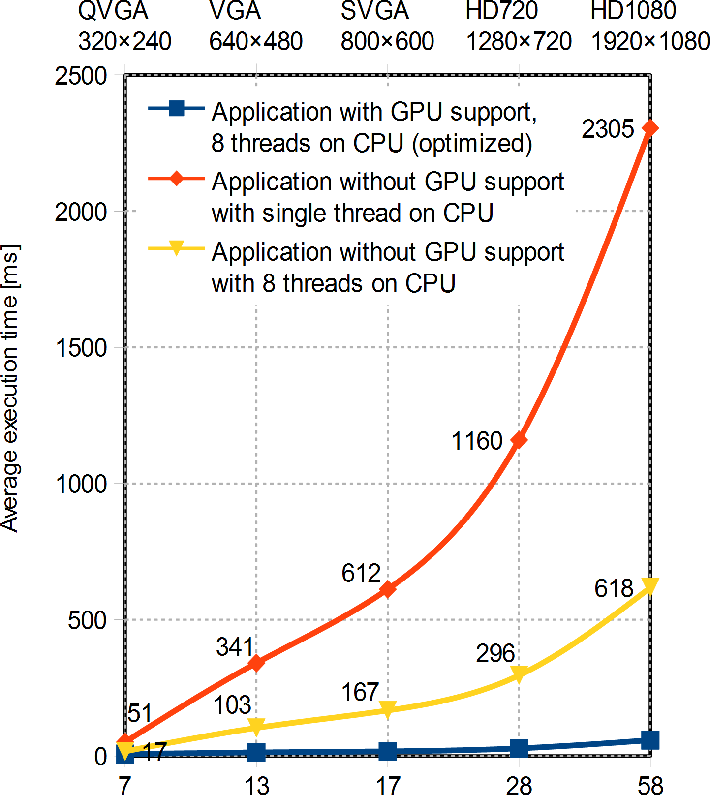
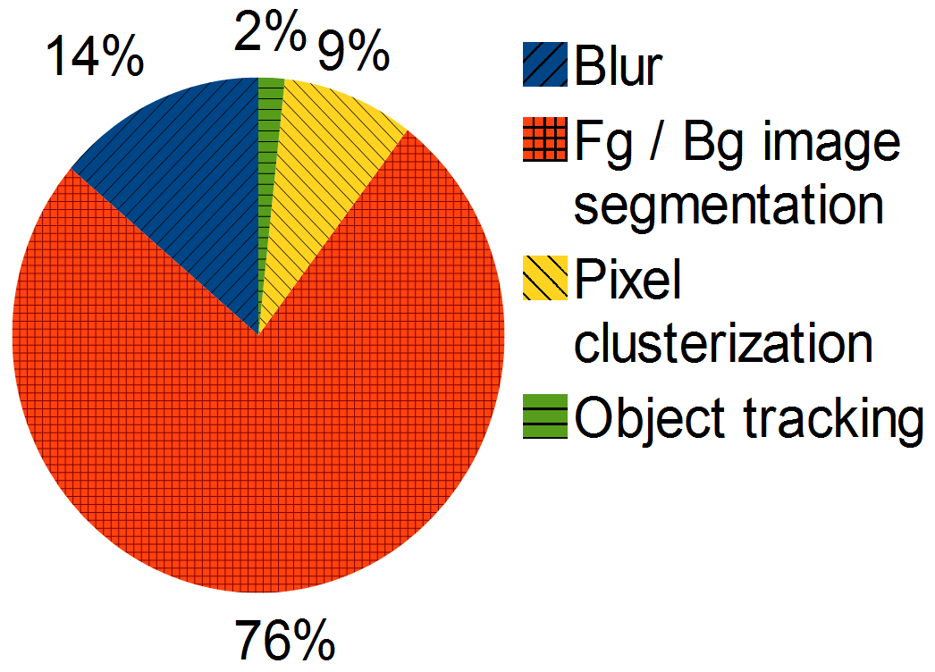
Experimental results
Execution time
Overall execution time of application
Execution time distribution per image processing component

Slide 12
Experimental results
Arised problems
Overlapping vehicles cause false positive and false negative detections
Environment conditions (sun reflection, rapid lighting changes), camera vibrations caused by strong wind or passing of large vehicles

Slide 13
Conclusion
Future work
One camera can be used for multiple lanes
Vehicle detection and tracking
Vehicle detection and trajectory estimation in real time
Measuring traffic flow
First results promising
Vehicle counting accuracy over 95%
Future work
Vehicle classification (bicyclist, car, truck)
Possible to use one camera per one road traffic network node
Computation of origin-destination matrix of a large road traffic network using license plate recognition

Slide 14
University of Zagreb
Faculty of Transport and Traffic Sciences
Acknowledgment
This research has been partially supported by
European Union from the European Regional Development Fund by the project IPA2007/HR/16IPO/001-040514 ”VISTA - Computer Vision Innovations for Safe Traffic”
Leading institution University of Zagreb, Faculty of electrical engineering and computing
EU COST action TU1102 - “Towards Autonomic Road Transport Support Systems”

Slide 15
Real time vehicle trajectory estimation on multiple lanes
Kristian Kovačić, Edouard Ivanjko, Hrvoje Gold
kristian.kovacic@fpz.hr

